Slide 1

Robben Island Cell Virtual Tour
Nyaniso Tukani
xolilizwenyaniso7@gmail.com
Phone Number: 0680304748

Slide 2
Choice of the project
The choice of the VR development I chose is creating a virtual tour for Robben Island Cells. As many people would like to see the history of South Africa. The cell of Nelson Mandela where he was kept for 27 years also Govern Mbeki who spent 23 years in jail.

Slide 3
Functionality of Robben Island Virtual Tour
The first thing when the tour start, you will start at the door then you will be able to walk through the passage. You will find the information in front about the tour.
You will first see the Nelson Mandela Cell where you will be able to open the cell to get inside and interact with objects inside.
You can walk out of Mandela Cell and walk to Govern Mbeki Cell and, also be able to interact with the tools there like turning on the TV using a remote and be able to grab the models.
Also there will be apartheid struggle music in background to enhance the VR tour and feel the apartheid struggle.

Slide 4
Technical Details of the Robben Island Virtual Tour
The technology that used is Unity3D to implement my virtual tour.
Firstly, is the usage of 3D Modelling tools, the making of cells and models that will be used including, lighting, textures.
I made use of the text panel explaining the use of the VR tour so that users can understand what they will come against. I also made use of audio to bring an immersive experience and added a screen that will display videos of apartheid.
Used Unity physical and interaction system to allow the user to interact with the objects that will be in the Virtual Tour. Like opening the Cells, grabbing, and interacting the remote with the TV screen.

Slide 5
Challenges Encountered
The challenge that I encountered is the continuous movement of the Virtual Tour. I tried many times to trigger the object of the game and I struggled but it did not discourage me not to implement my Virtual Tour.

Slide 6
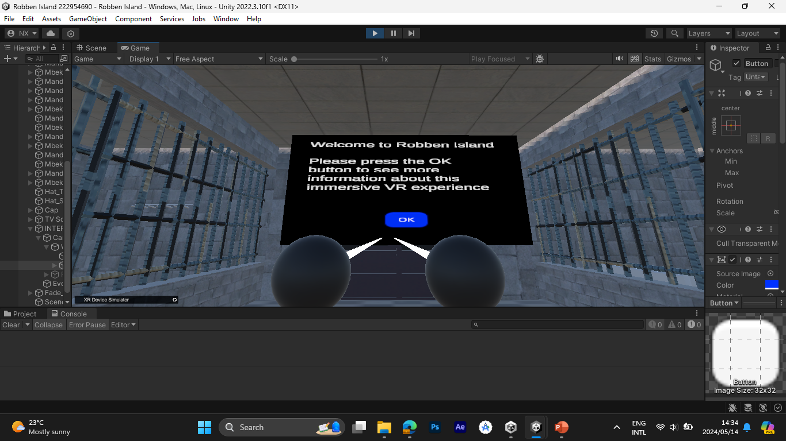
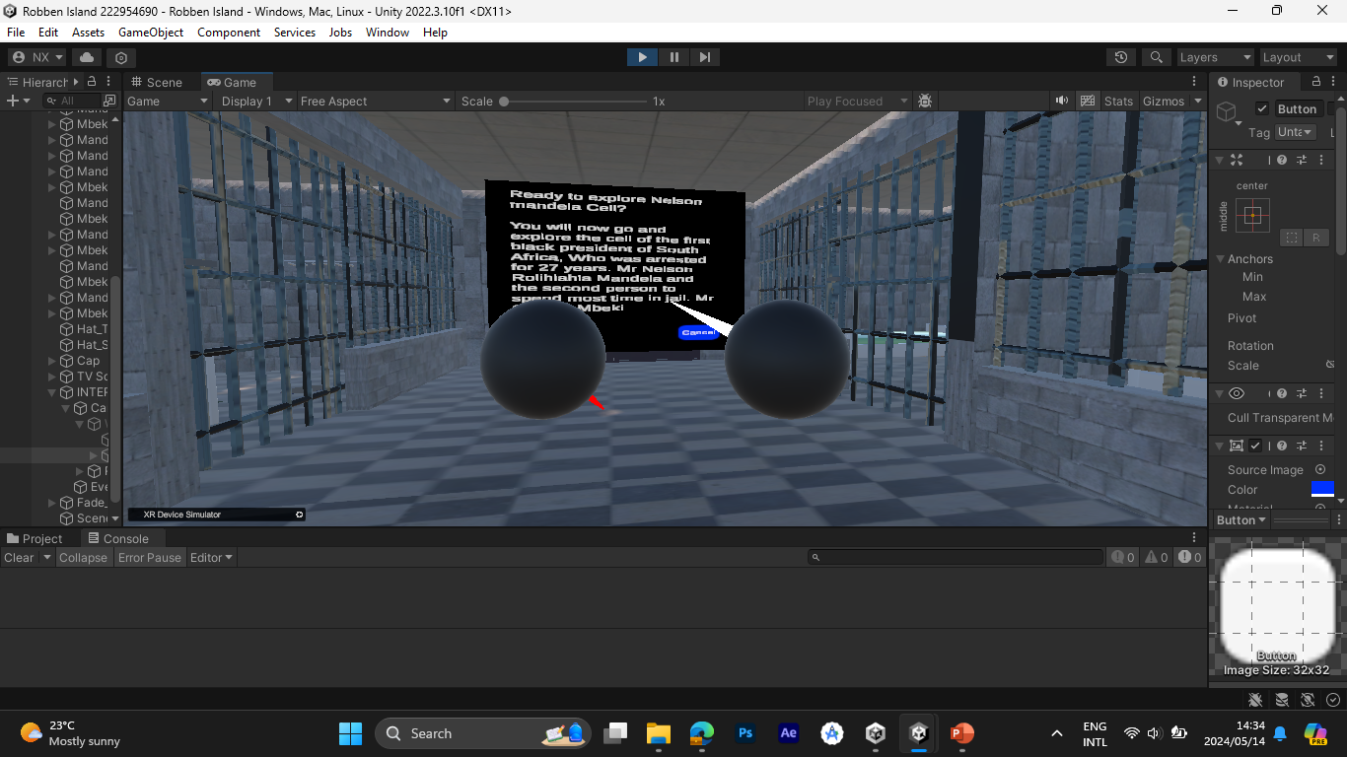
Demo Presentation

Slide 7
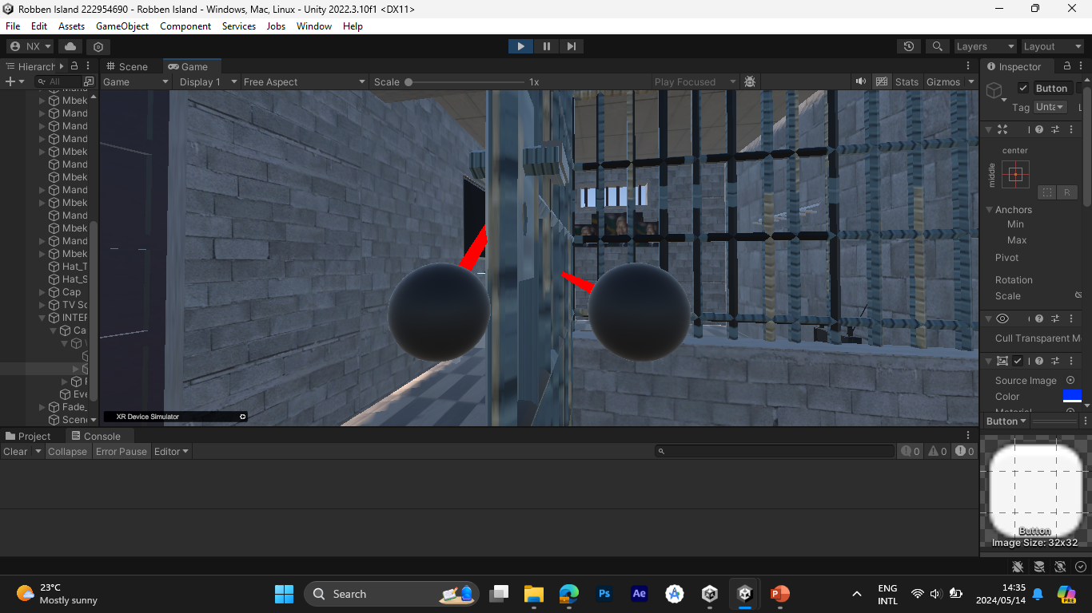
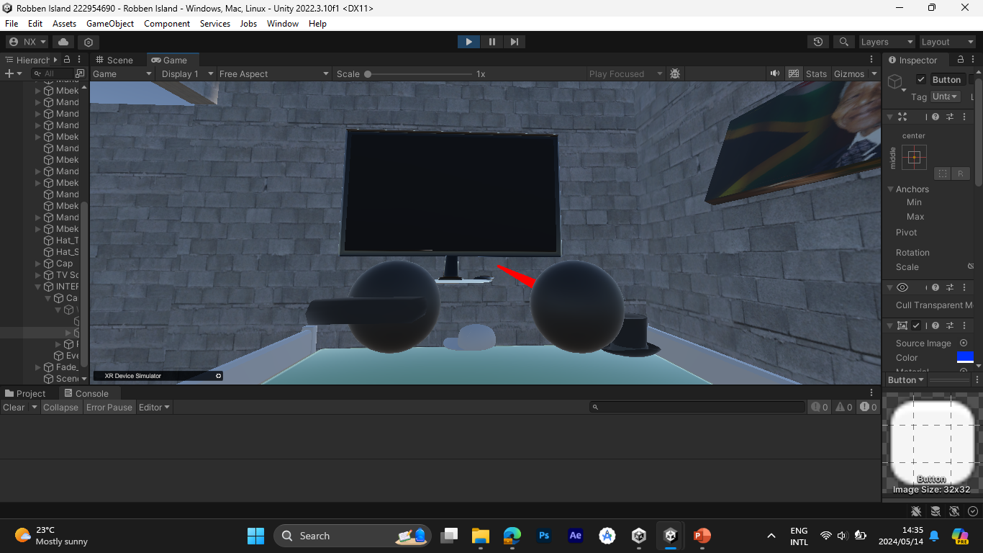
Demo

Slide 8
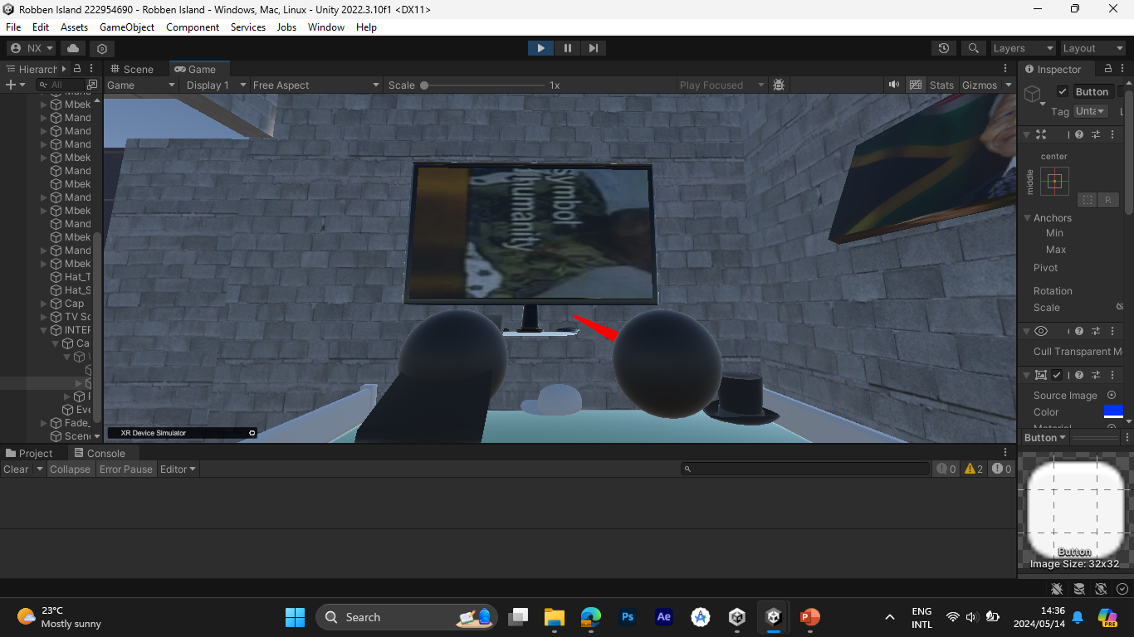
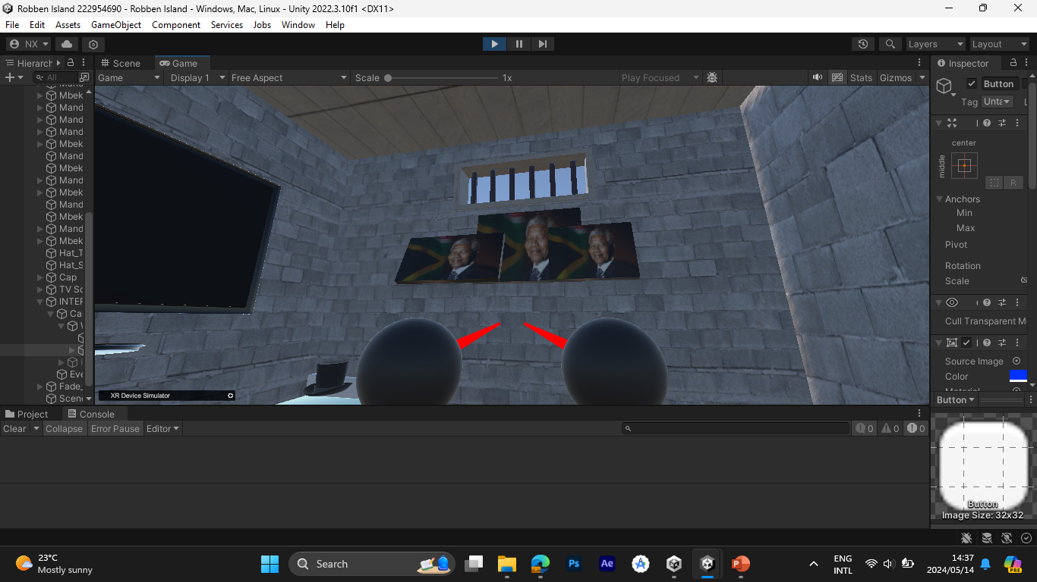
Demo

Slide 9
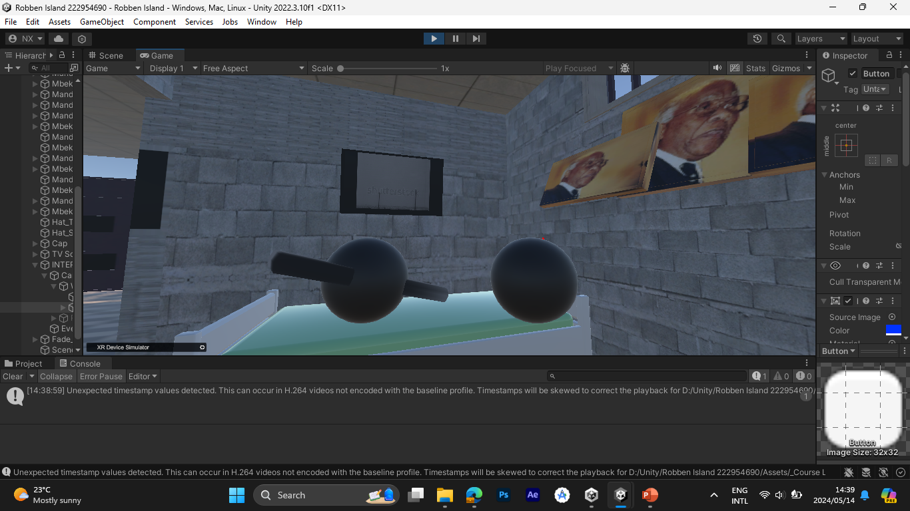
Demo

